Slide 1

Hotel Receptionist Management System (core java)
Presented by,
Nikita suryawanshi
Guided by,
Mrs. Pavitra

Slide 2
Introduction :
This is a Hotel Receptionist Management System which can be used to manage activities like storing customer details, booking rooms of four different types, ordering food for particular rooms, unbooking rooms and showing the bill. It can also be used to see different room features and room availability.

Slide 3
Objective:
To avoid manual and repetitive work
Real time information of availability of rooms.
Receptionist can reserve and check available rooms book that rooms

Slide 4
Which topic covered in project:
Classes and Objects
Inheritance
File Handling with Objects
ArrayList
implementing Interface
User defined exception and Exception handling.

Slide 5
Software Requirement :
Eclipse IDE
Windows 10 or above.
RAM: 4GB or above.
Hardware Requirement:

Slide 6

Use case Diagram:
Login
Display room details
Display room availability
Book Room
Receptionist
Order food
checkout

Slide 7

Flow diagram :
start
Login
Display room details
Room
available
N
Recheck
add details
And book
Food order
N
checkout
Y
add list of food
Display bill
Exit

Slide 8
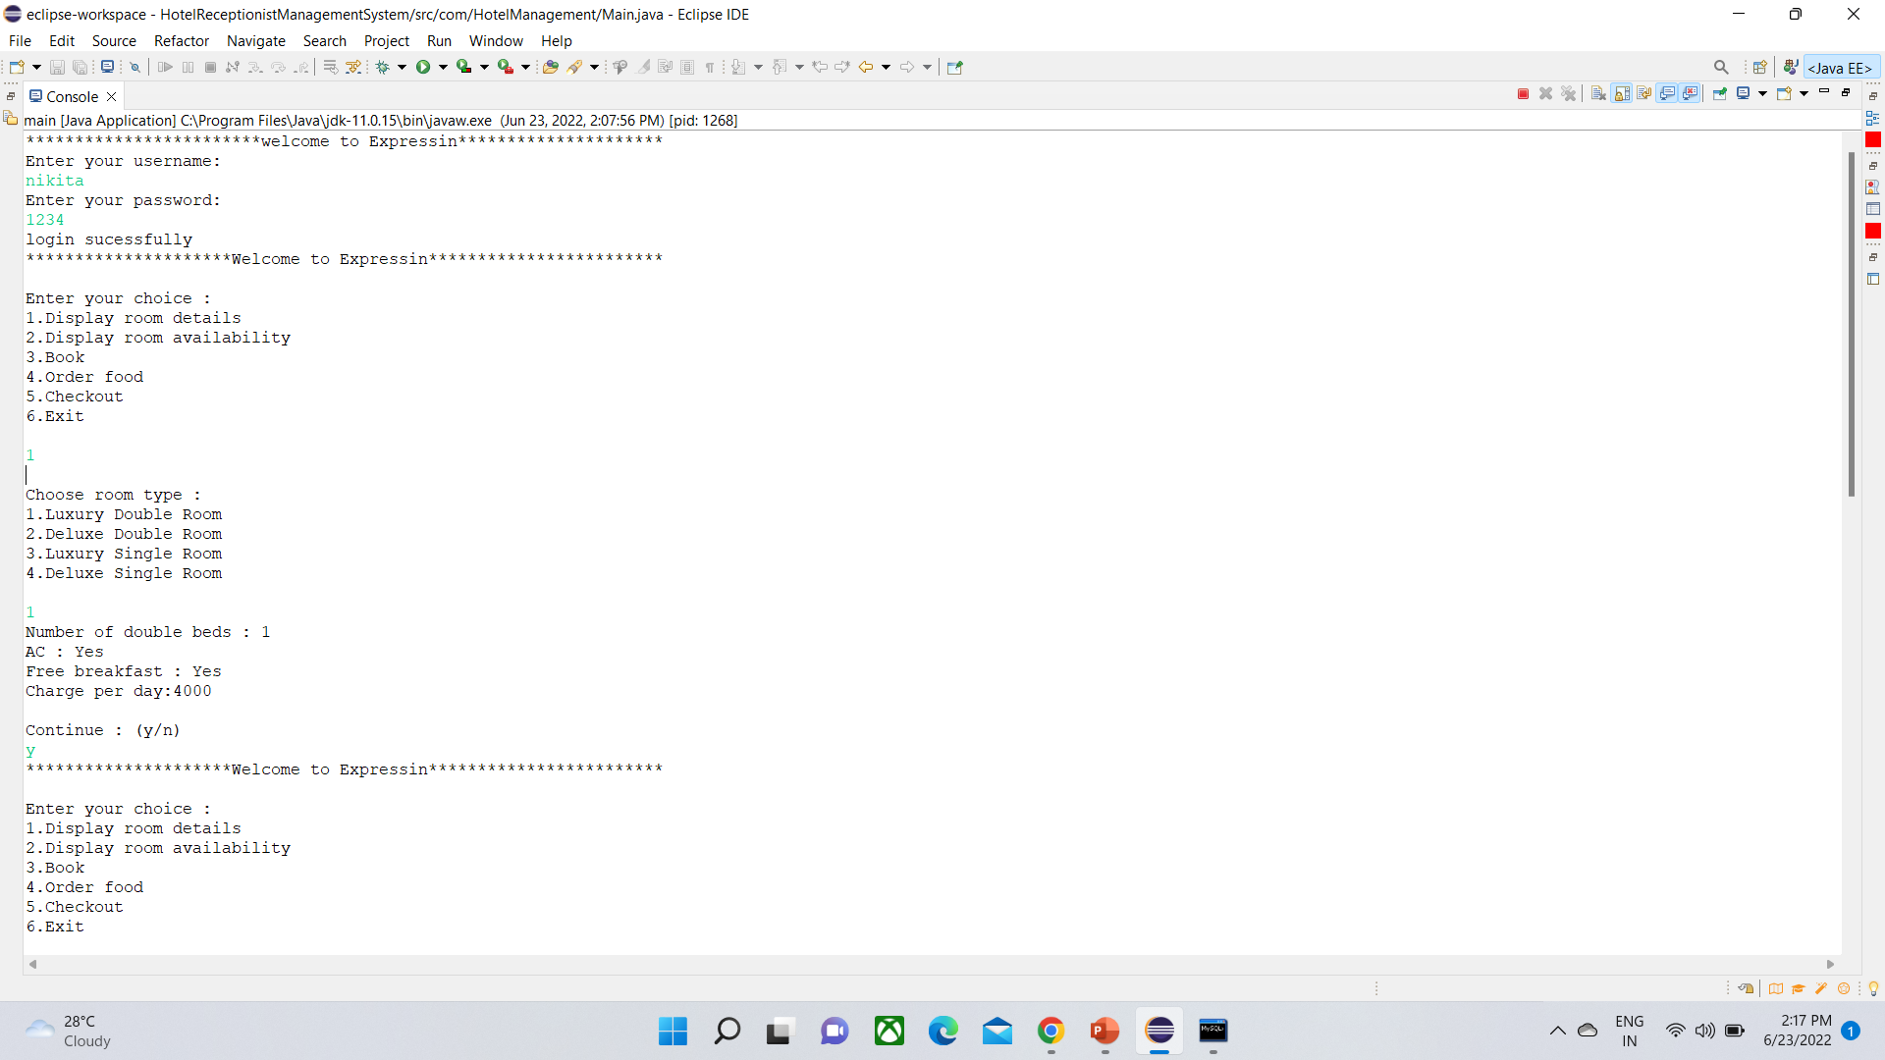
Display room details:

Slide 9
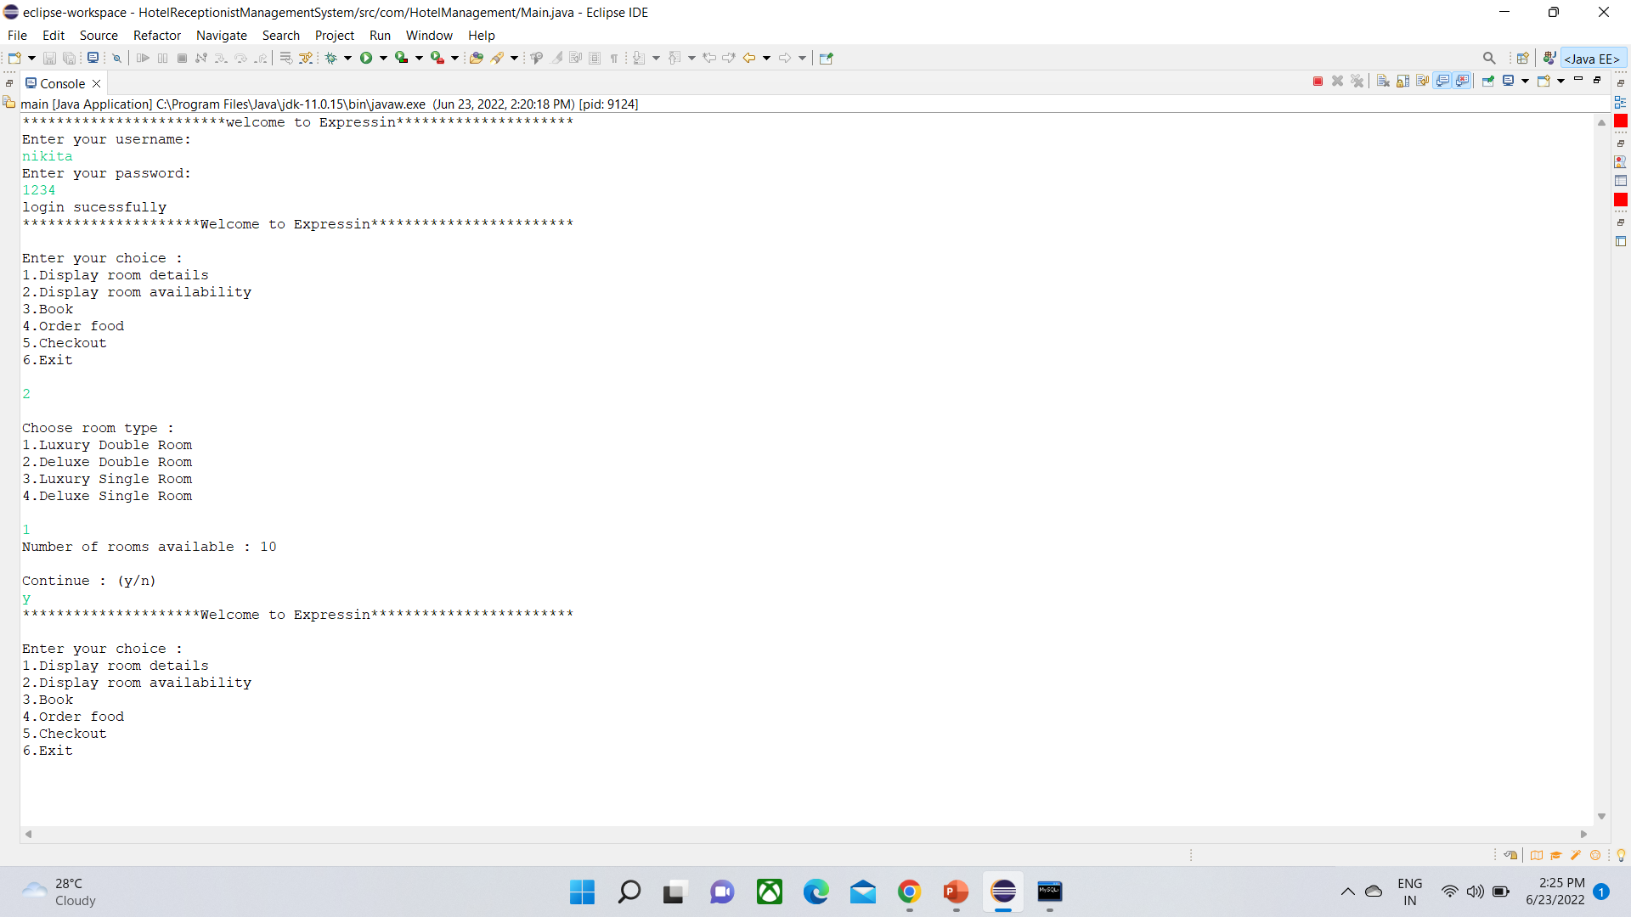
Display room availability

Slide 10
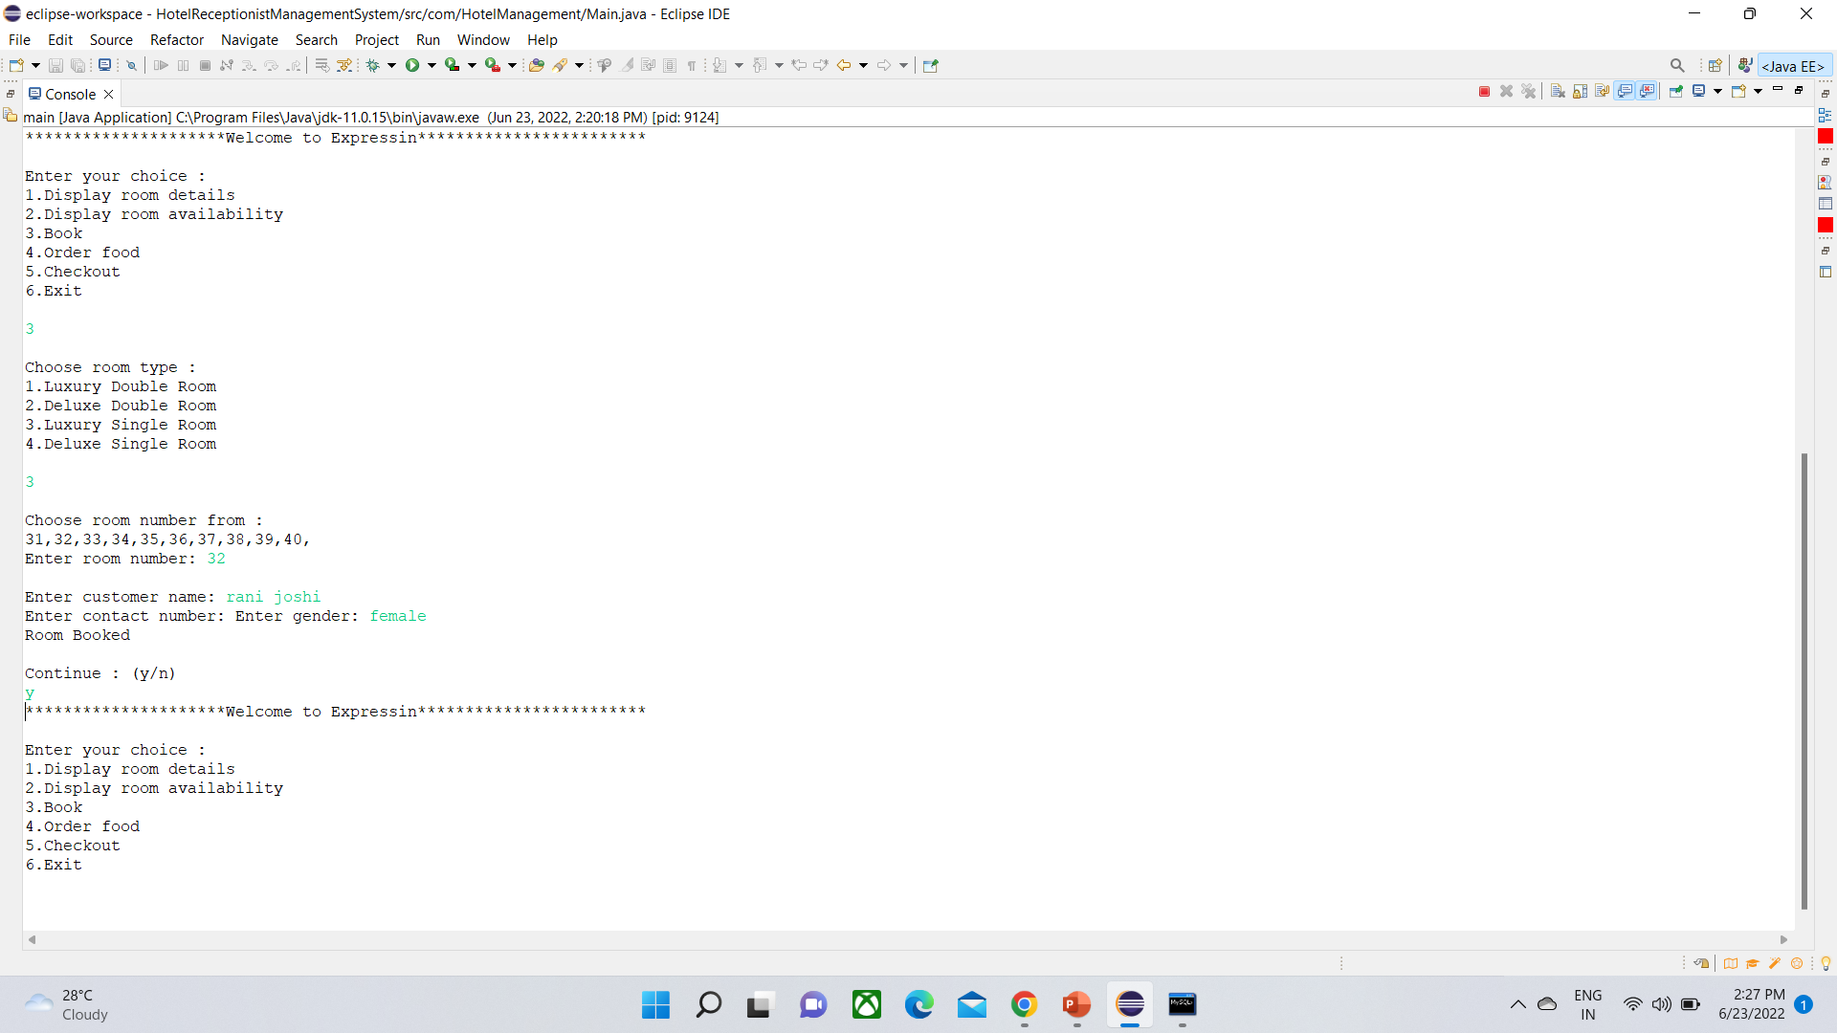
Room Booking

Slide 11
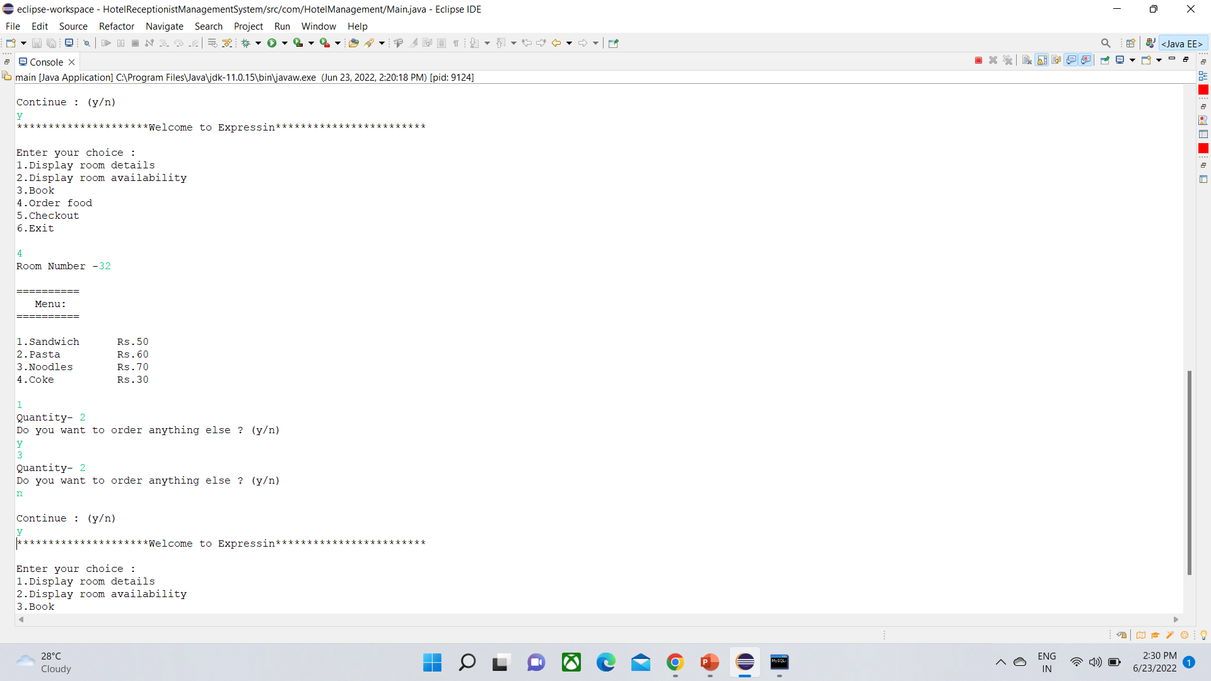
Order Food

Slide 12
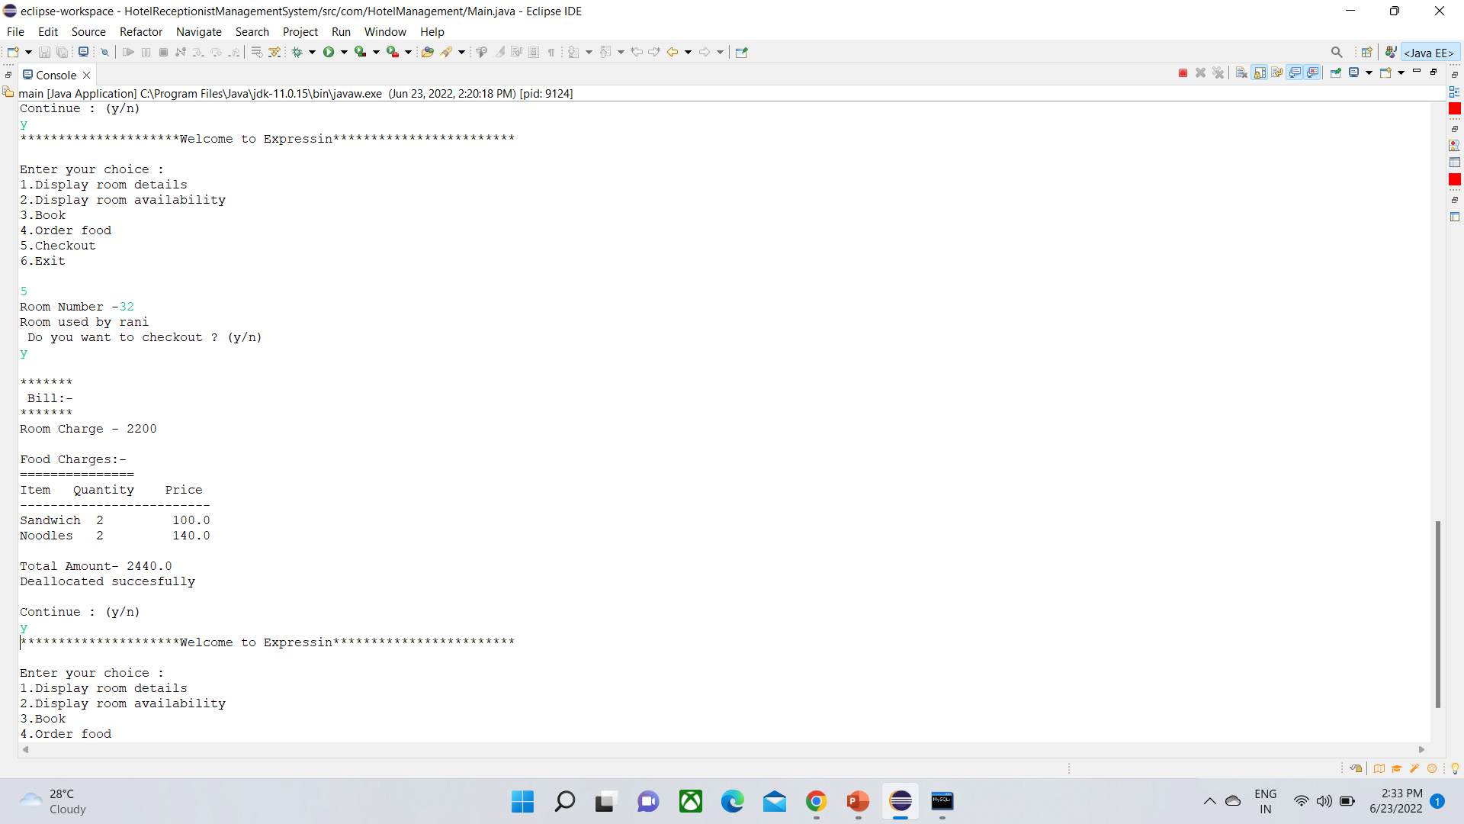
Checkout

Slide 13
Code of Project :
Main
Loginpart
Userdetails
Validator

Slide 14
Future scope
We make hotel management system same as this project.
We can create web page
We can add more facilities .

Slide 15
Conclusion:
This is a Hotel Receptionist Management System which can be used to manage activities like storing customer details, booking rooms of four different types, ordering food for particular rooms, unbooking rooms and showing the bill. It can also be used to see different room features and room availability.

Slide 16
References :
https://www.javatpoint.com/how-to-use-eclipse-for-java
https://www.javatpoint.com/file-operations-in-java
https://www.w3schools.com/java/java_inheritance.asp

Slide 17
Thank you

